Slide 1






Lab 1 : Data Preprocessing
Impute Missing Value
Prof. Chia-Yu Lin
National Central University
2026 Spring

Slide 2
Lab1 Activity
Objectives:
Learn how to handle and impute missing values in a dataset using Python (NumPy & Pandas).
Why This Matters:
Real‑world datasets almost always contain missing values. Before any modeling or analysis, you must clean and preprocess the data to avoid biased or incorrect results.
What You Will Practice Today:
Identifying missing values (NaN) in a DataFrame
Removing rows that contain missing values
Filling missing values with a constant (e.g., 0)
Filling missing values with statistical measures (e.g., mean)
Understanding how different imputation strategies affect the dataset

Slide 3
Lab 1 Submission
Follow the description of Q1-3 to finish in “LAB1-Data Preprocessing.ipynb”
Upload “LAB1-Data Preprocessing.ipynb” to eeclass.
Deadline: 23:30 on Mar 16.

Slide 4
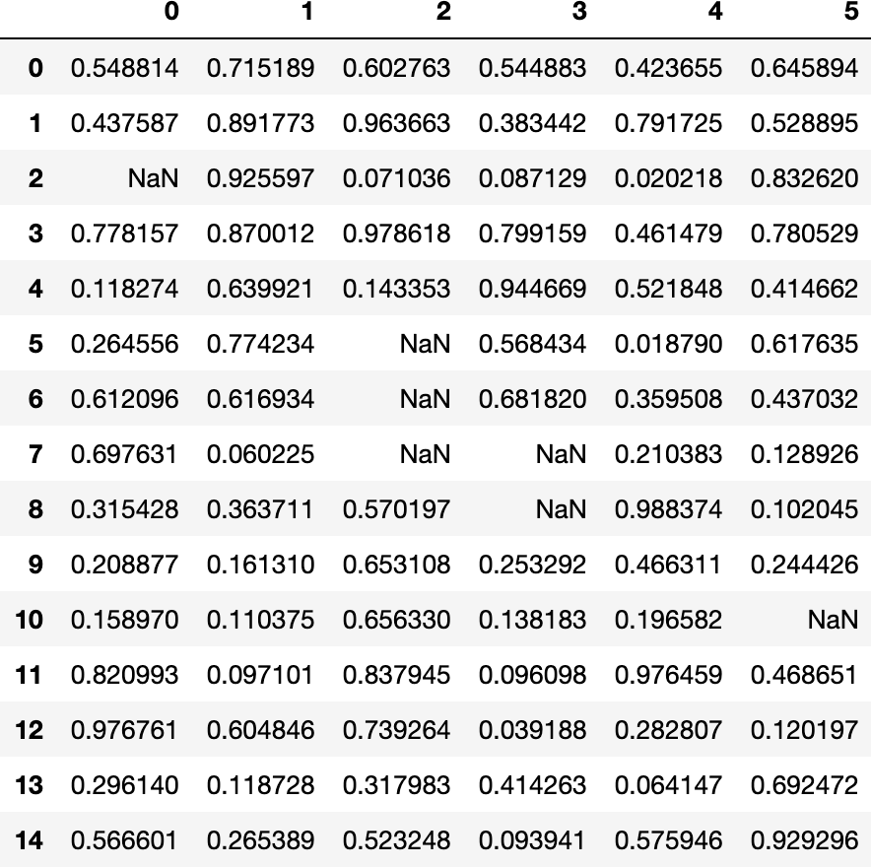
Dataset for the Lab
We will generate a synthetic dataset with random numbers and intentionally insert NaN values.
Use this dataset to apply different imputation techniques.
import numpy as np
from numpy import nan as NA import pandas as pd
import numpy.random as random
random.seed(0)
df2 = pd.DataFrame(np.random.rand(15, 6))
df2.iloc[2,0] = NA df2.iloc[5:8,2] = NA
df2.iloc[7:9,3] = NA df2.iloc[10,5] = NA
df2

Slide 5
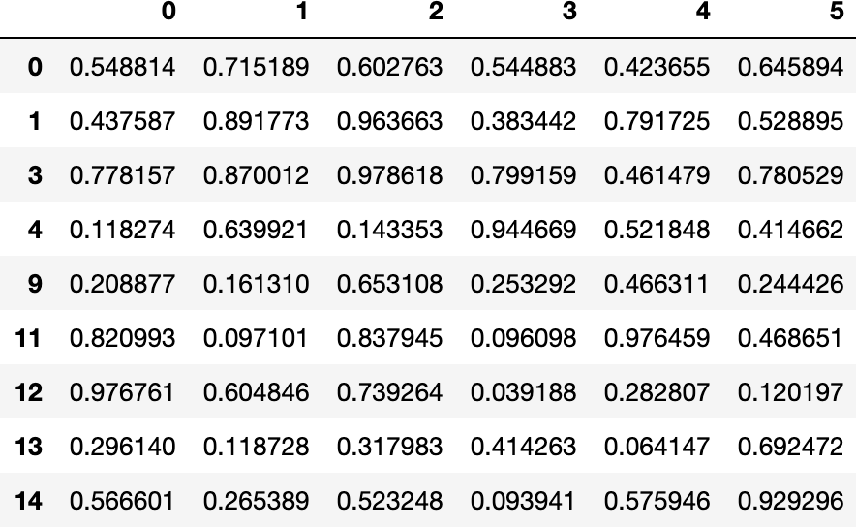
Q 1 Delete the row with NaN.
1. Delete rows that contain any NaN values
Result:
Hint: You may find helpful examples of missing‑value imputation in:
1.Data Preprocessing_python-code.pptx Slides 64–72

Slide 6
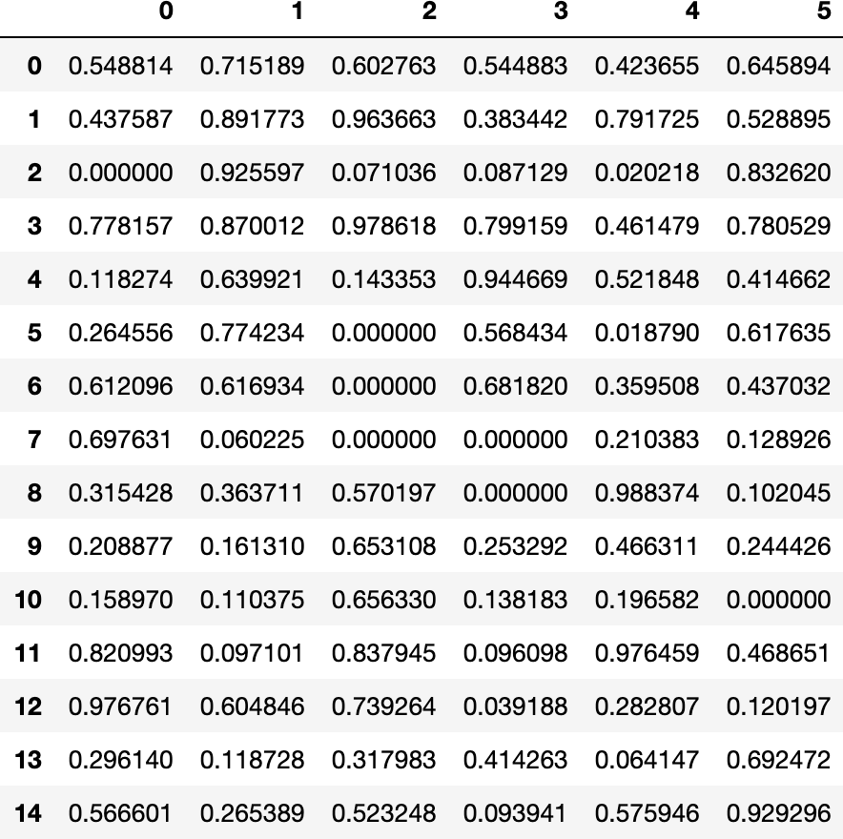
Q 2 Fill 0 for NaN
2. Fill NaN values with 0
Result:
Hint: You may find helpful examples of missing‑value imputation in:
1.Data Preprocessing_python-code.pptx Slides 64–72

Slide 7
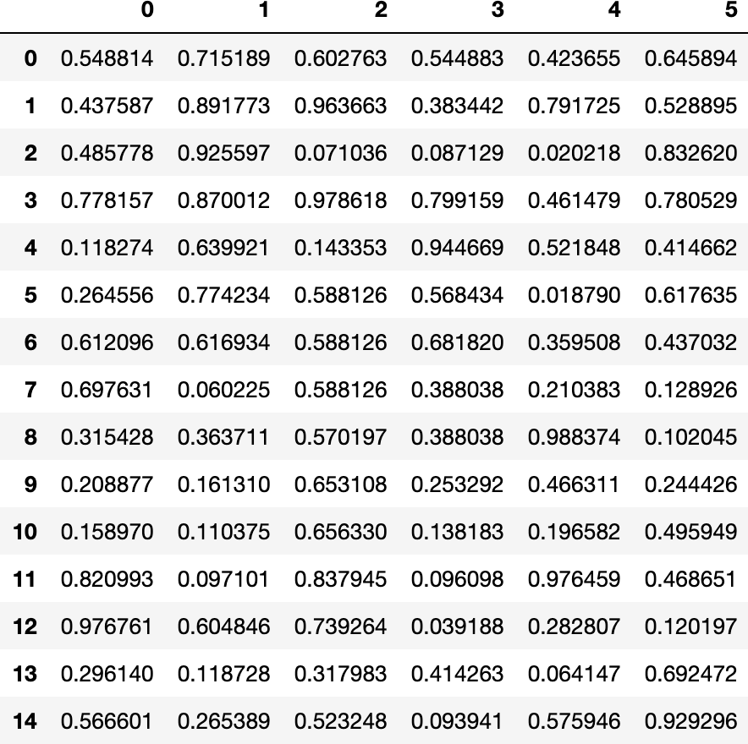
Q 3 Fill mean value for NaN
3. Fill NaN values with the mean of each column
Result:
Hint: You may find helpful examples of missing‑value imputation in:
1.Data Preprocessing_python-code.pptx Slides 64–72

